Slide 1
Computational principles of cultural learning
Xavier Roberts-Gaal, CogSci
28/7/2023

Slide 2





Cumulative culture relies on a learning mechanism

Slide 3
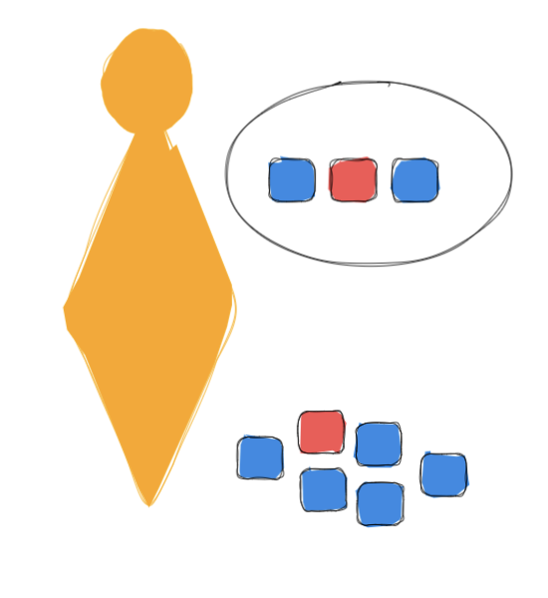

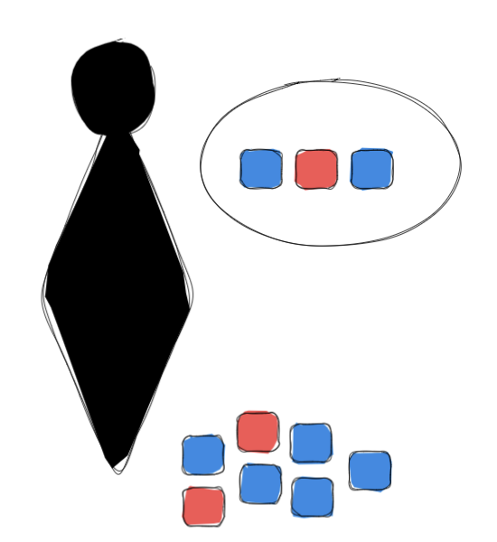
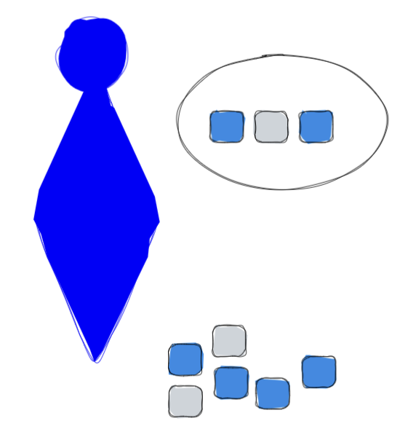
Competing theories of cultural learning emphasize low-cost imitation, or flexible but expensive causal models
Low-cost, high-fidelity imitation
Computationally, model-free RL
Flexible causal models of goals, values, and the world
Computationally, model-based RL
Image: Dall•E 2

Slide 4



But it’s clear that people use both
Henrich & Henrich, 2010 Proc Bio Sci; Images: Dall•E 2

Slide 5
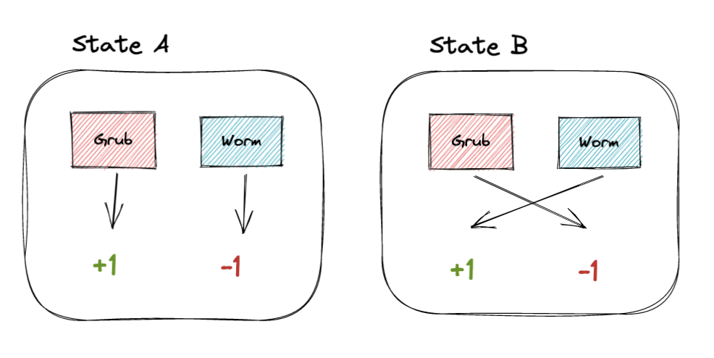
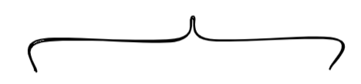
One answer, building on Giuliano & Nunn: the environment determines when to learn from others
Model: A volatile environment
World state is re-sampled with some probability (Δ)
see Giuliano & Nunn, 2021 Rev Econ Stud, also Boyd & Richerson, 1980 J Econ Behav Org, Rogers,, 1988 Amer Anthro

Slide 6
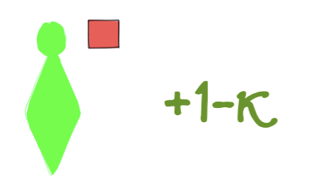
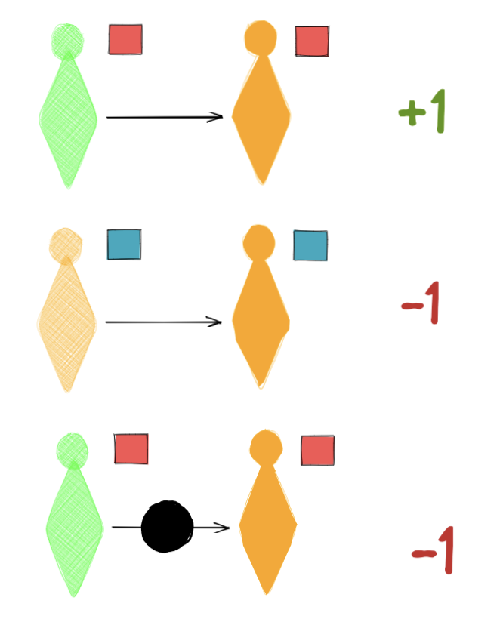
One answer, building on Giuliano & Nunn: the environment determines when to learn from others
Model: A volatile environment
with individual and (model-free) social learners
Individual learners pay a learning cost (κ) to find the right action
Social learners pay no cost, but can get it wrong if the environment changes or if they learn the wrong goal
World state is re-sampled with some probability (Δ)
see Giuliano & Nunn, 2021 Rev Econ Stud, also Boyd & Richerson, 1980 J Econ Behav Org, Rogers,, 1988 Amer Anthro

Slide 7
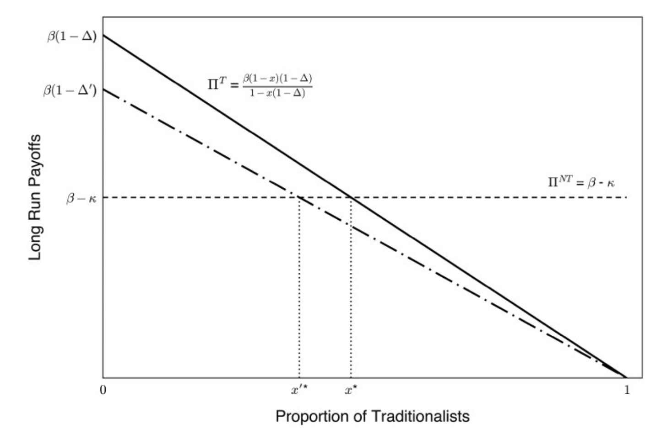
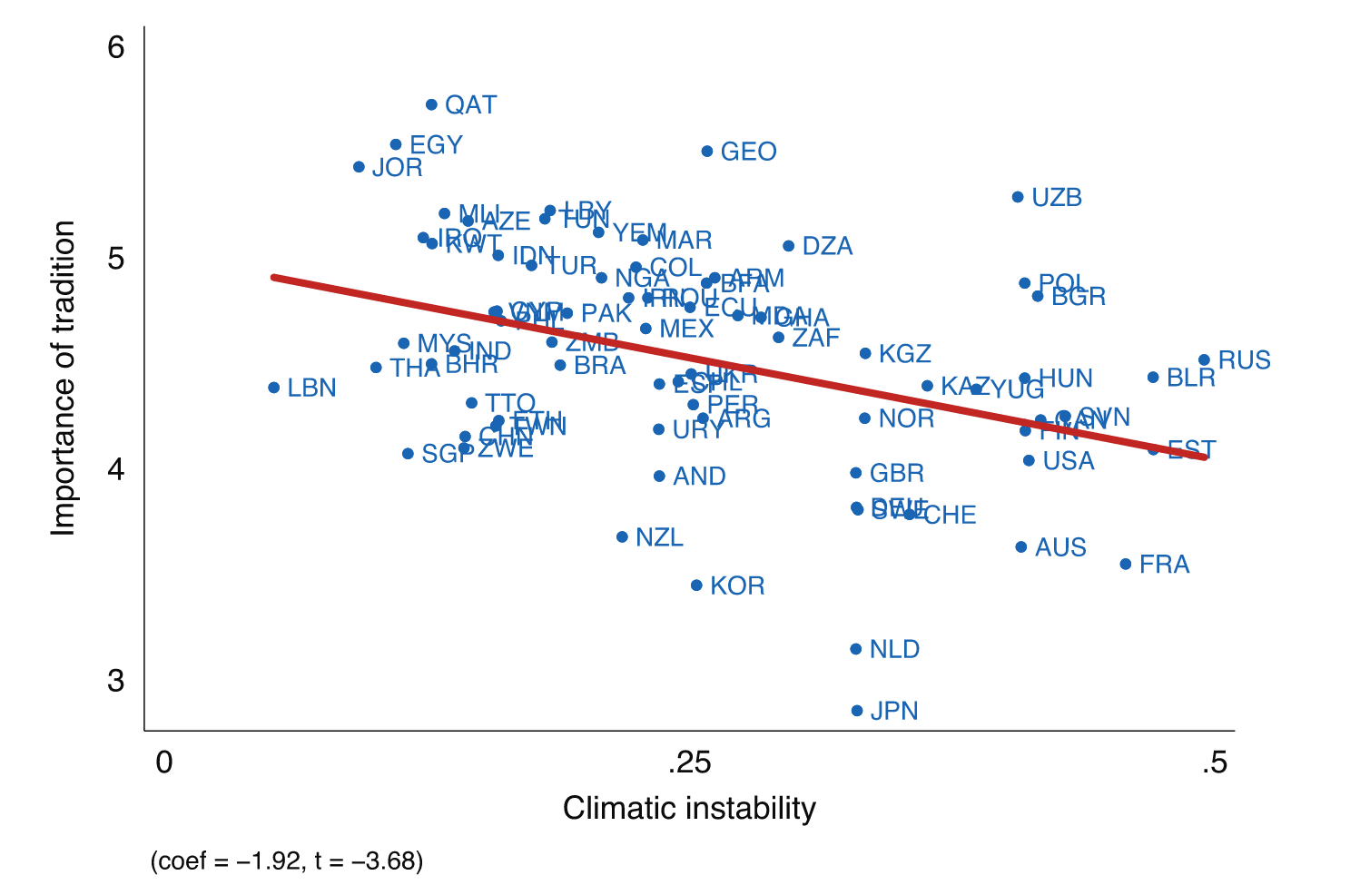
GN: Analytical and empirical results support the key role of the environment in determining learning strategy
Analytical model
Empirical results
Equilibrium between social & individual learning
People whose ancestral cultures experienced less volatility were more likely to prioritize tradition/social learning
Position of the equilibrium depends on volatility (shock probability, Δ) and IL cost (κ)
Long-run payoffs
Proportion of social learners
from Giuliano & Nunn, 2021 Rev Econ Stud

Slide 8
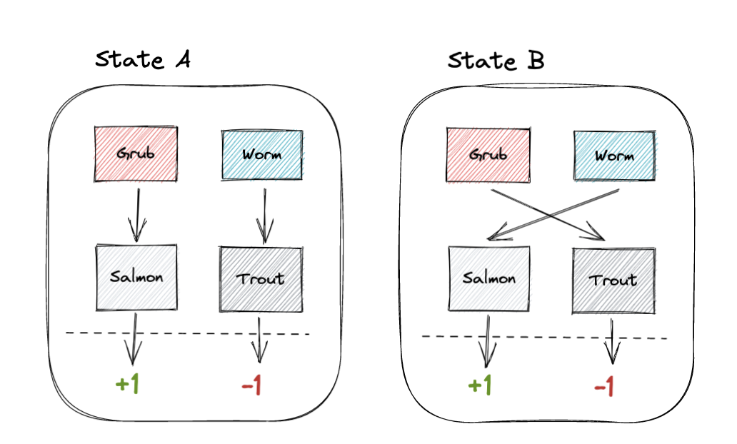
We extend G&N’s agent-based model of environmental shocks to allow for model-based social learning
A population in a volatile environment…
…where shocks alter the transition structure between actions and observed outcomes…
…and where reward is unobserved by default
Subject to stochastic shocks
see Giuliano & Nunn, 2021 Rev Econ Stud

Slide 9
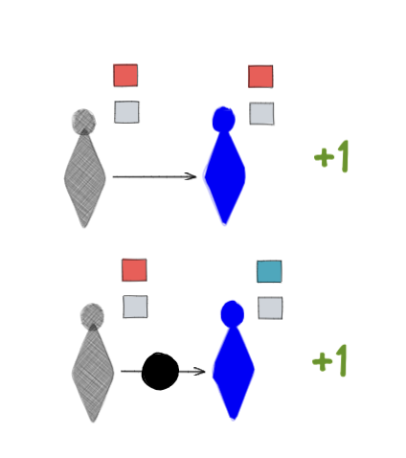
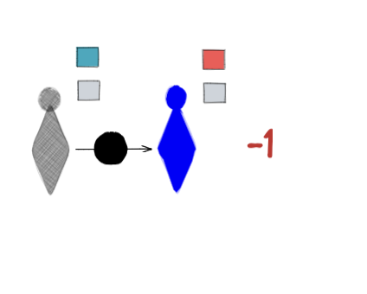
In this model, we observe how MF, MB, and IL agents compete under different learning conditions
We introduce model-based learners, which pay a cost (λ) to learn the environment’s structure and infer goals
MB are partially immune from environmental shocks, but can copy the wrong goal

Slide 10
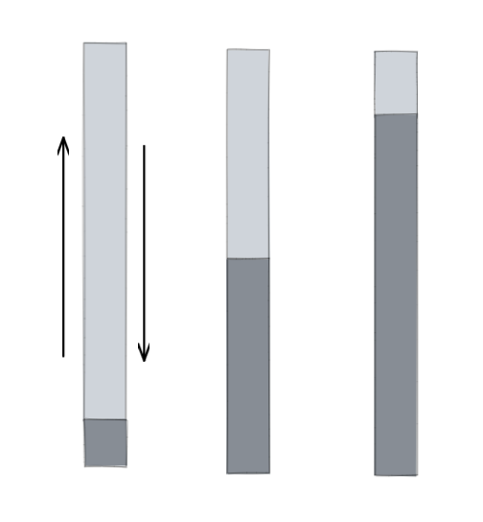
In this model, we observe how MF, MB, and IL agents compete under different learning conditions
We introduce model-based learners, which pay a cost (λ) to learn the environment’s structure and infer goals
MB are partially immune from environmental shocks, but can copy the wrong goal
We vary three parameters: volatility, and individual and model-based learning costs
Δ
λ
κ
Volatility
MB
cost
IL
cost

Slide 11
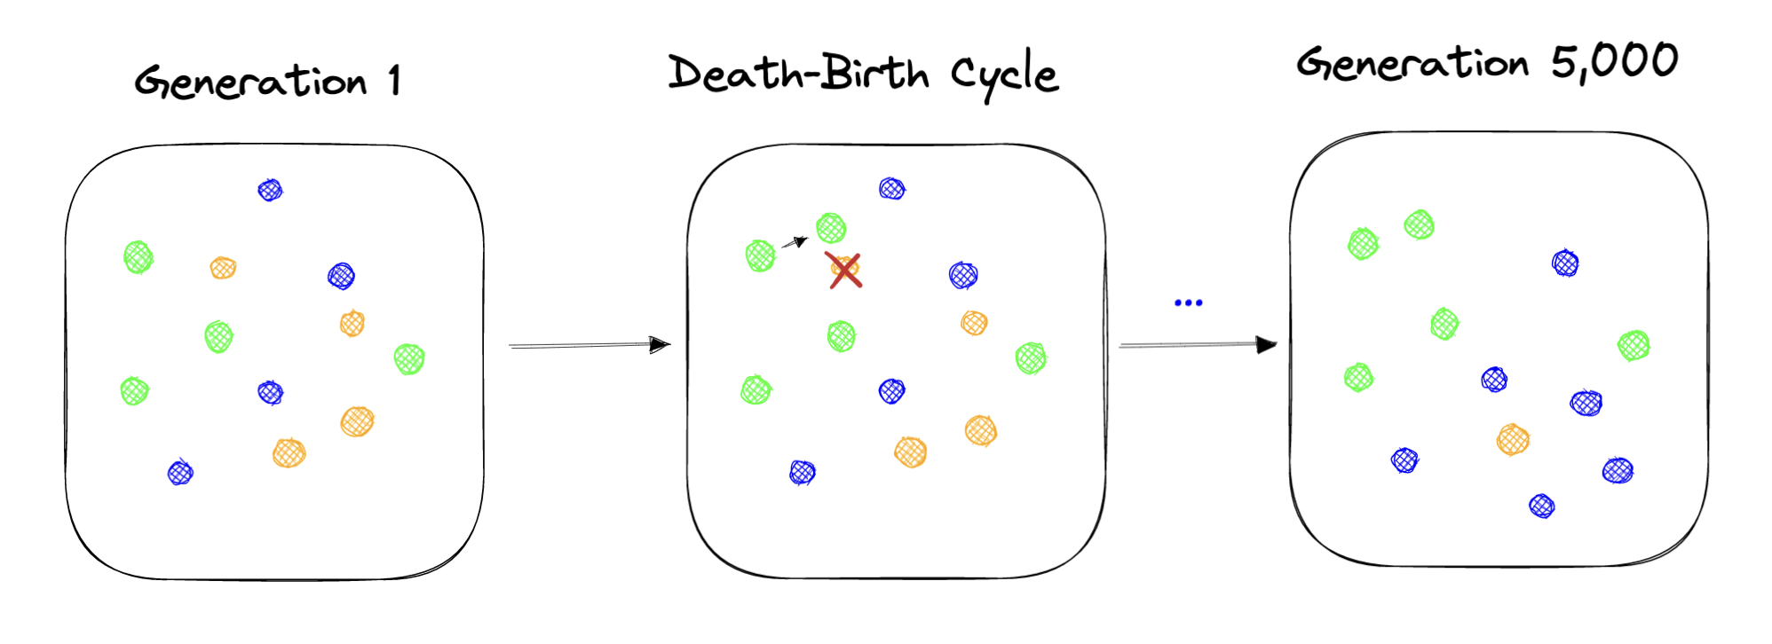
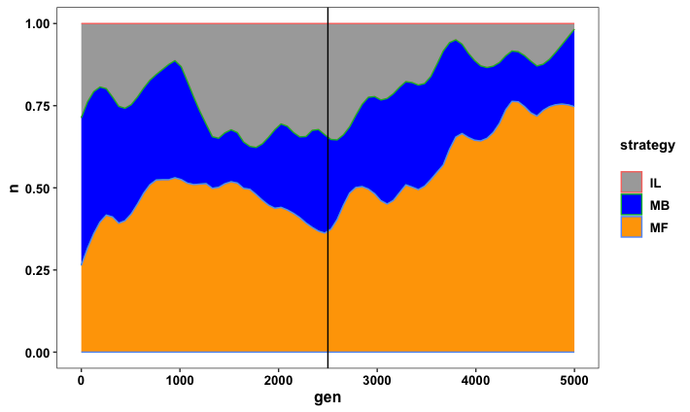
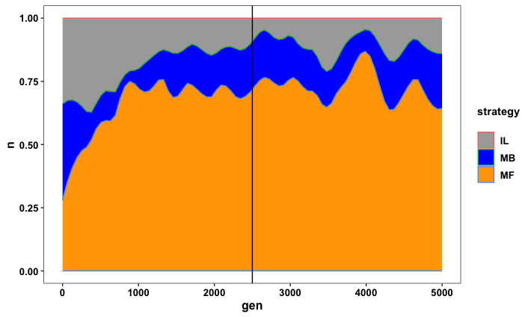
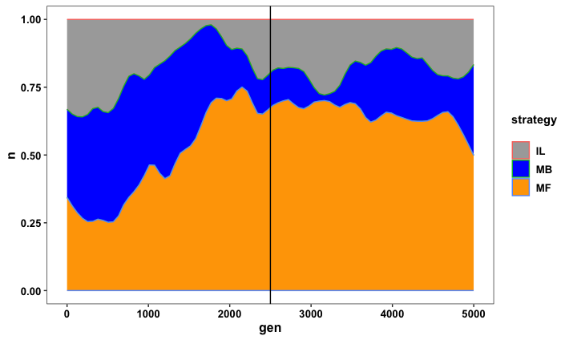

We employ a Moran process
A Moran process…
Stochastic: finite population, one random death/generation
Selection: parents reproduce with P = softmax(payoff)
Mutation: children inherit/acquire* the parents’ type, with a small chance of acquiring a random type
Volatility: chance of shock between each generation
…repeated many times
Thousands of simulations with different seeds and parameters
Fully reproducible code
Model-based
Model-free
Individual
*not assuming a specific route (e.g., Baldwin, 1896; Heyes, Chater, & Dyer 2020; Henrich, 2017). Moran process: Ewens, 2004; Nowak et al., 2004

Slide 12
Social vs. individual learning

Slide 13
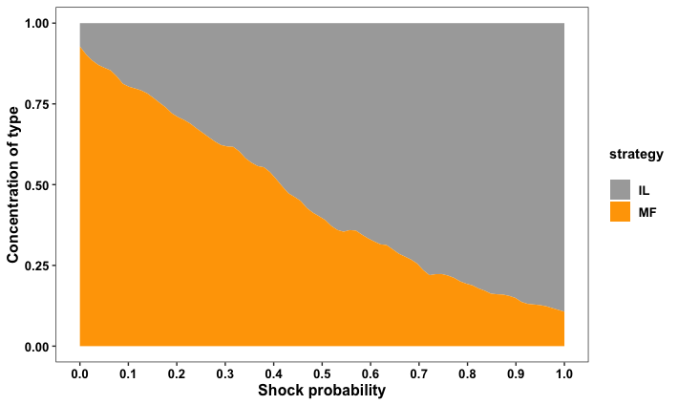
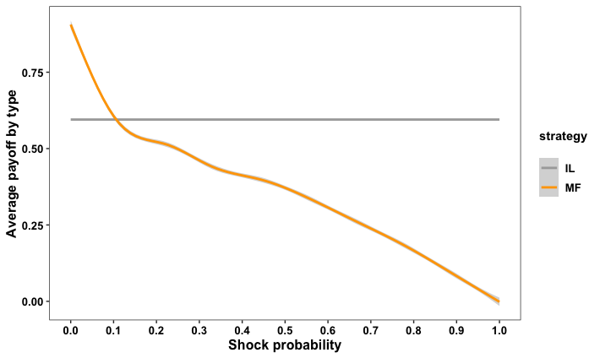
We replicate Giuliano & Nunn, finding social learners’ proportions and payoffs vary by volatility
Proportions of social vs. individual learners
Payoffs of social vs. individual learners
1-κ
Environmental volatility (Δ)
Environmental volatility (Δ)
1k+ simulations, long-run proportions/payoffs averaged over gens 2.5-5k

Slide 14
Model-free and model-based social learning

Slide 15
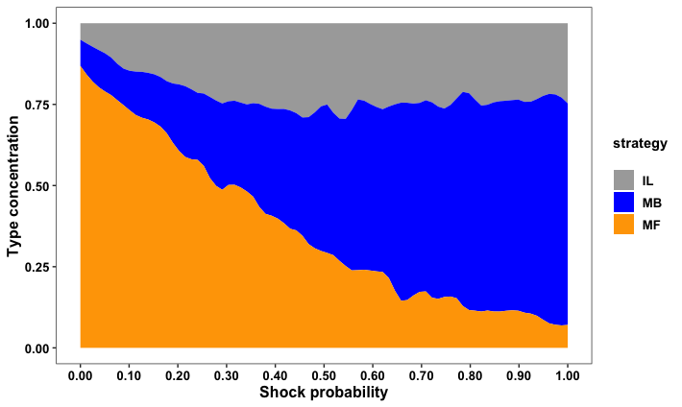
Under moderate learning conditions, the balance between MF and MB agents depends on volatility
Volatility varied
Δ
λ
κ
Learning costs fixed
1k+ simulations with parameters λ = 0.2; κ = 0.4

Slide 16
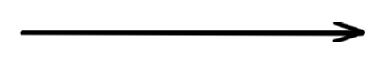
Volatile environments favor MB social learning more strongly when model-fitting costs are lower
λ = 0.2
κ = 0.4
X axis: increasing environmental volatility (Δ)

Slide 17
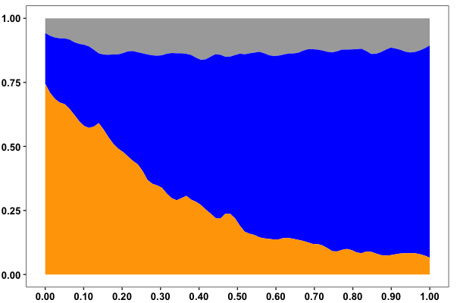
Volatile environments favor MB social learning more strongly when model-fitting costs are lower
λ = 0.1
λ = 0.2
κ = 0.4
κ = 0.4
X axis: increasing environmental volatility (Δ)

Slide 18
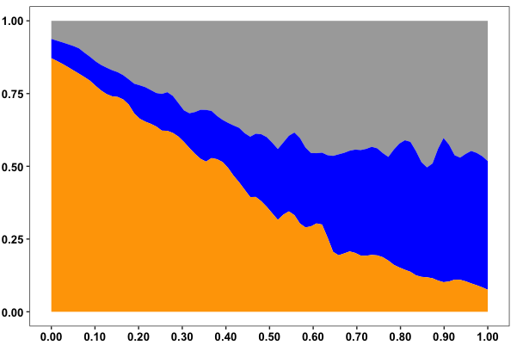
Volatile environments favor MB social learning more strongly when model-fitting costs are lower
λ = 0.1
λ = 0.2
λ = 0.3
κ = 0.4
κ = 0.4
κ = 0.4
X axis: increasing environmental volatility (Δ)

Slide 19
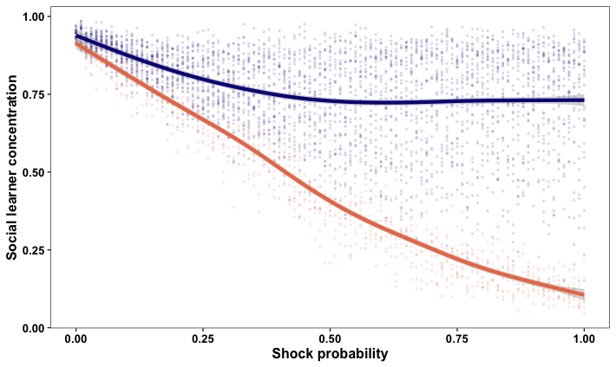
Model-based learning partially immunizes social learners against environmental shock
Orange line: only model-free social learners (GN)
Purple line: social learners including intermediate, model-based strategy (MB + MF)
4k+ simulations, λ ∈ {0.1, 0.2, 0.3}; κ = 0.4

Slide 20
Taking a step back…

Slide 21
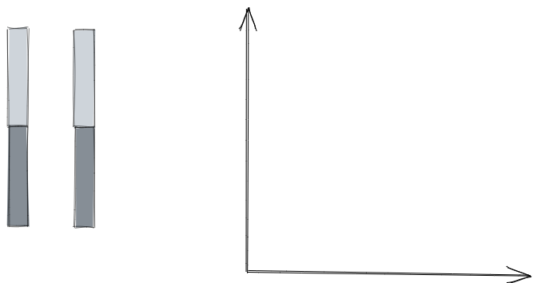
Distinct learning regimes emerge when examining the entire range of learning costs
Individual learning cost
κ
λ
Model-based learning cost

Slide 22
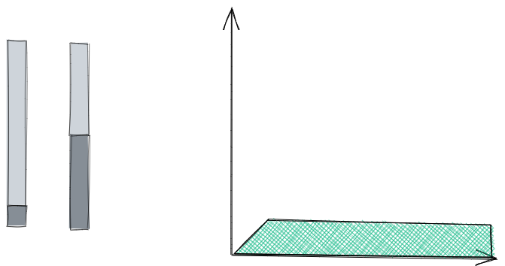
Domination by individual learners occurs when it is trivially cheap to be an individual learner
Individual learning cost
κ
λ
Model-based learning cost
Environmentally insensitive (Δ)

Slide 23
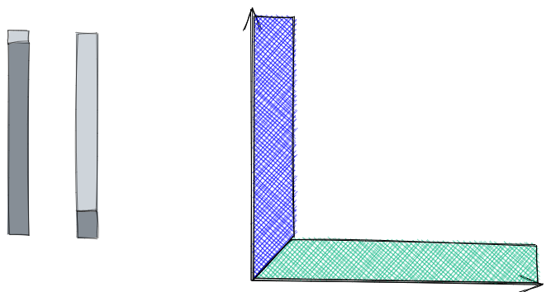
High individual and trivially cheap model-based costs lead to ~absorption by model-based learners
Individual learning cost
κ
λ
Model-based learning cost
Environmentally insensitive (Δ)

Slide 24
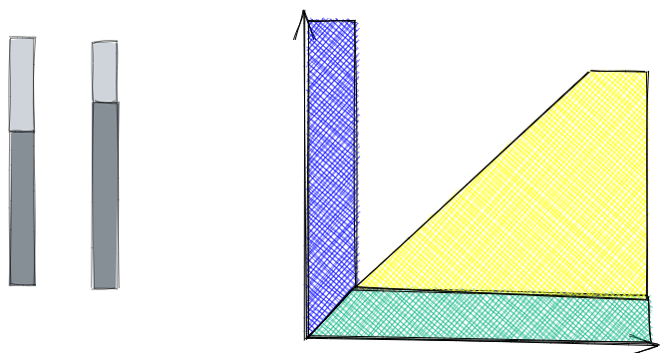
When model-based learning is more expensive than individual learning, we see GN dynamics
GN: mix of individual and MF social learners
Individual learning cost
κ
λ
Model-based learning cost
Sensitive to environmental volatility (Δ)

Slide 25
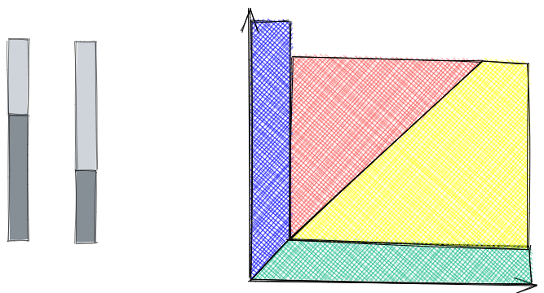
Our model describes a moderate regime where all types coexist, subject to environmental pressure
Moderate: mix of all three types, going to MB/IL as volatility increases
Individual learning cost
κ
λ
Model-based learning cost
Sensitive to environmental volatility (Δ)

Slide 26
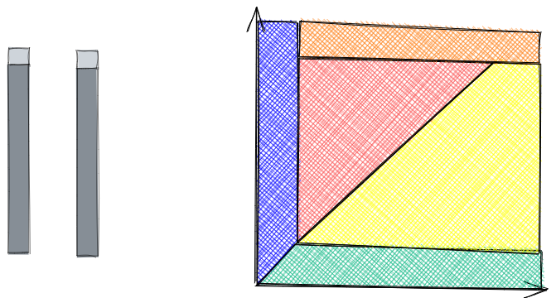
We also show that under extreme learning costs, model-free learning is the least bad option
Individual learning cost
κ
λ
Model-based learning cost
Environmentally insensitive (Δ)

Slide 27
Key takeaways
1. Cultural evolutionary modeling helps show why, and when, we employ each element of our cultural learning arsenal

Slide 28
Key takeaways
1. Cultural evolutionary modeling helps show why, and when, we employ each element of our cultural learning arsenal
2. The environment may be a key driver of coordination on social learning strategies

Slide 29
Key takeaways
1. Cultural evolutionary modeling helps show why, and when, we employ each element of our cultural learning arsenal
2. The environment may be a key driver of coordination on social learning strategies
3. Specifically, model-based social learning may play a crucial role in insulating social learners from environmental volatility

Slide 30

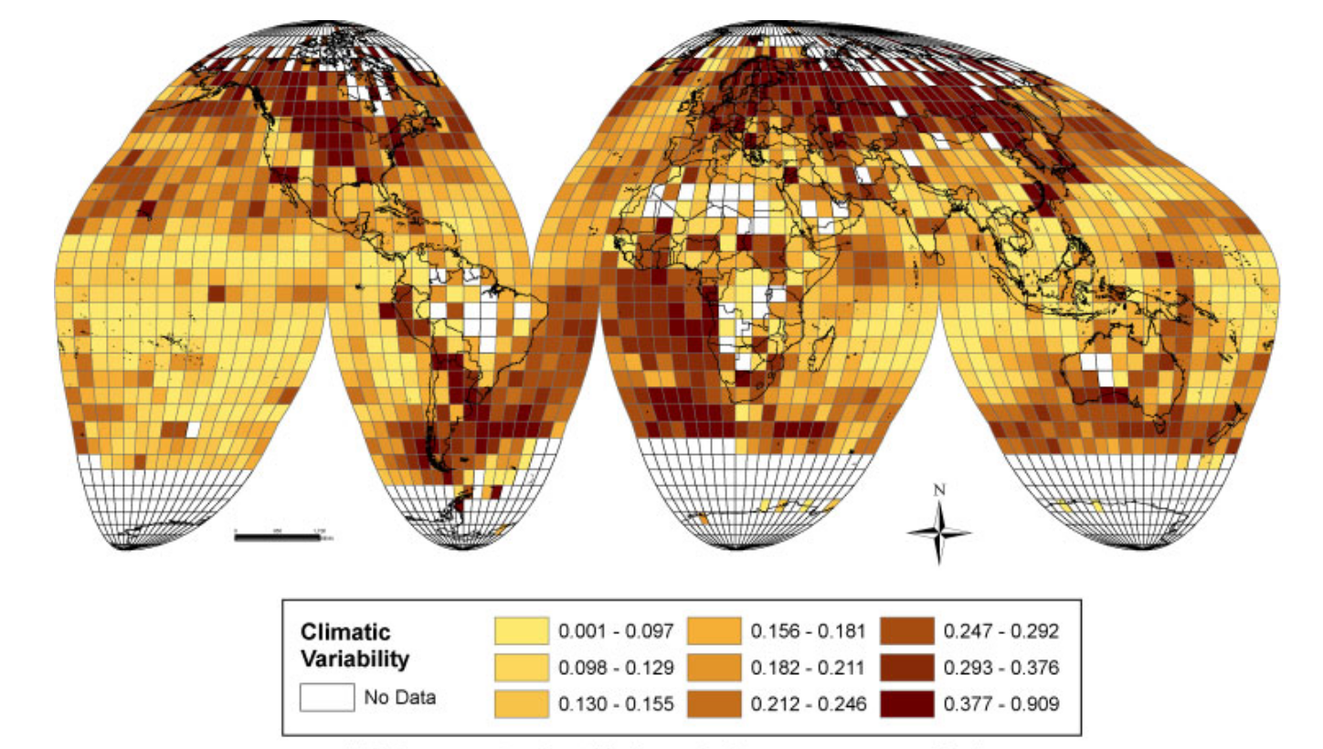

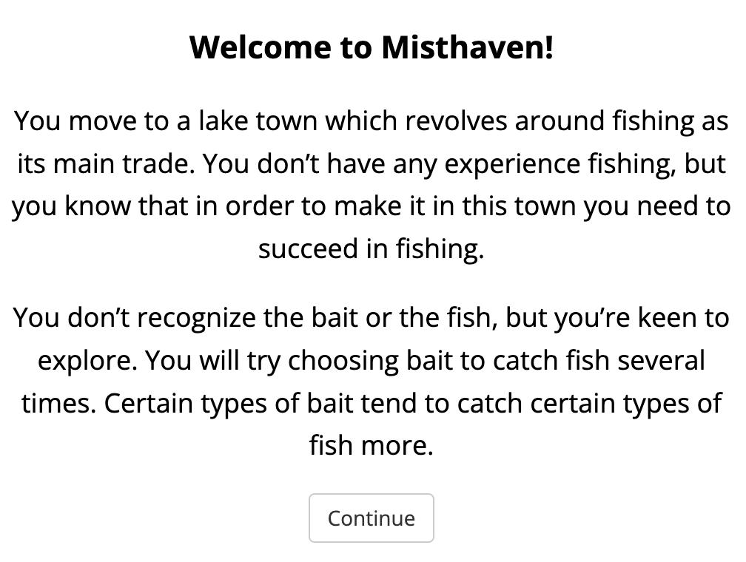
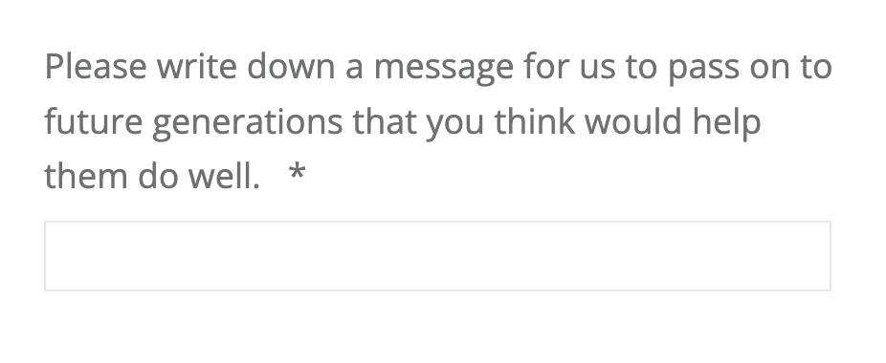
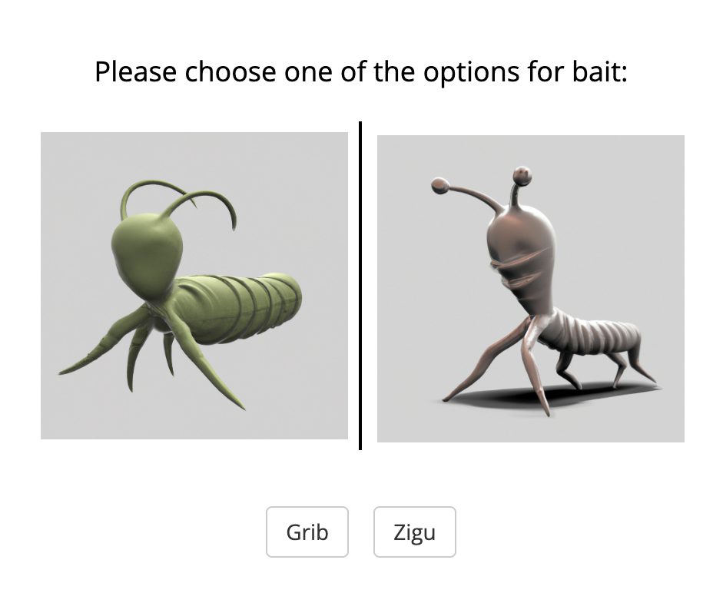

Key takeaways
Next steps
1. Cultural evolutionary modeling helps show why, and when, we employ each element of our cultural learning arsenal
1. Study: test whether IDs in preference for MB/MF learning correlate with ancestral environmental variability
Mira Becker
2. The environment may be a key driver of coordination on social learning strategies
2. Experiment: use iterated learning to create micro-cultures and test whether they coordinate on MB/MF learning
3. Specifically, model-based social learning may play a crucial role in insulating social learners from environmental volatility
Marija Bolic
Mann et al., 2009 Science, Alesina et al., 2013 QJE, GN

Slide 31

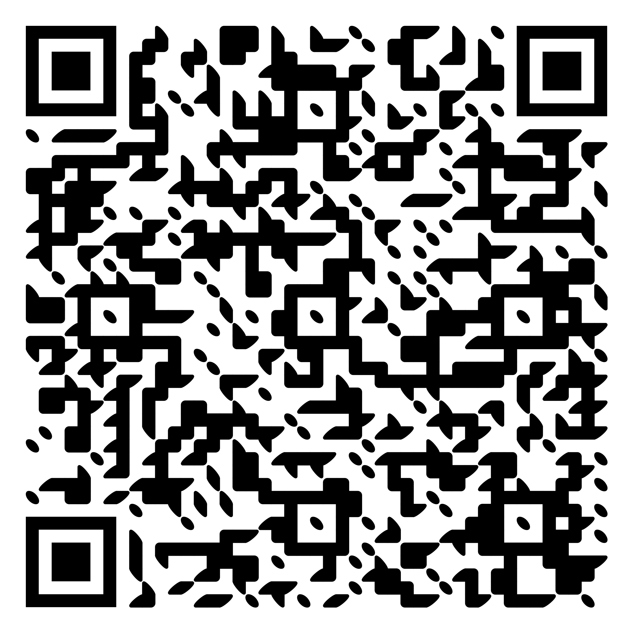
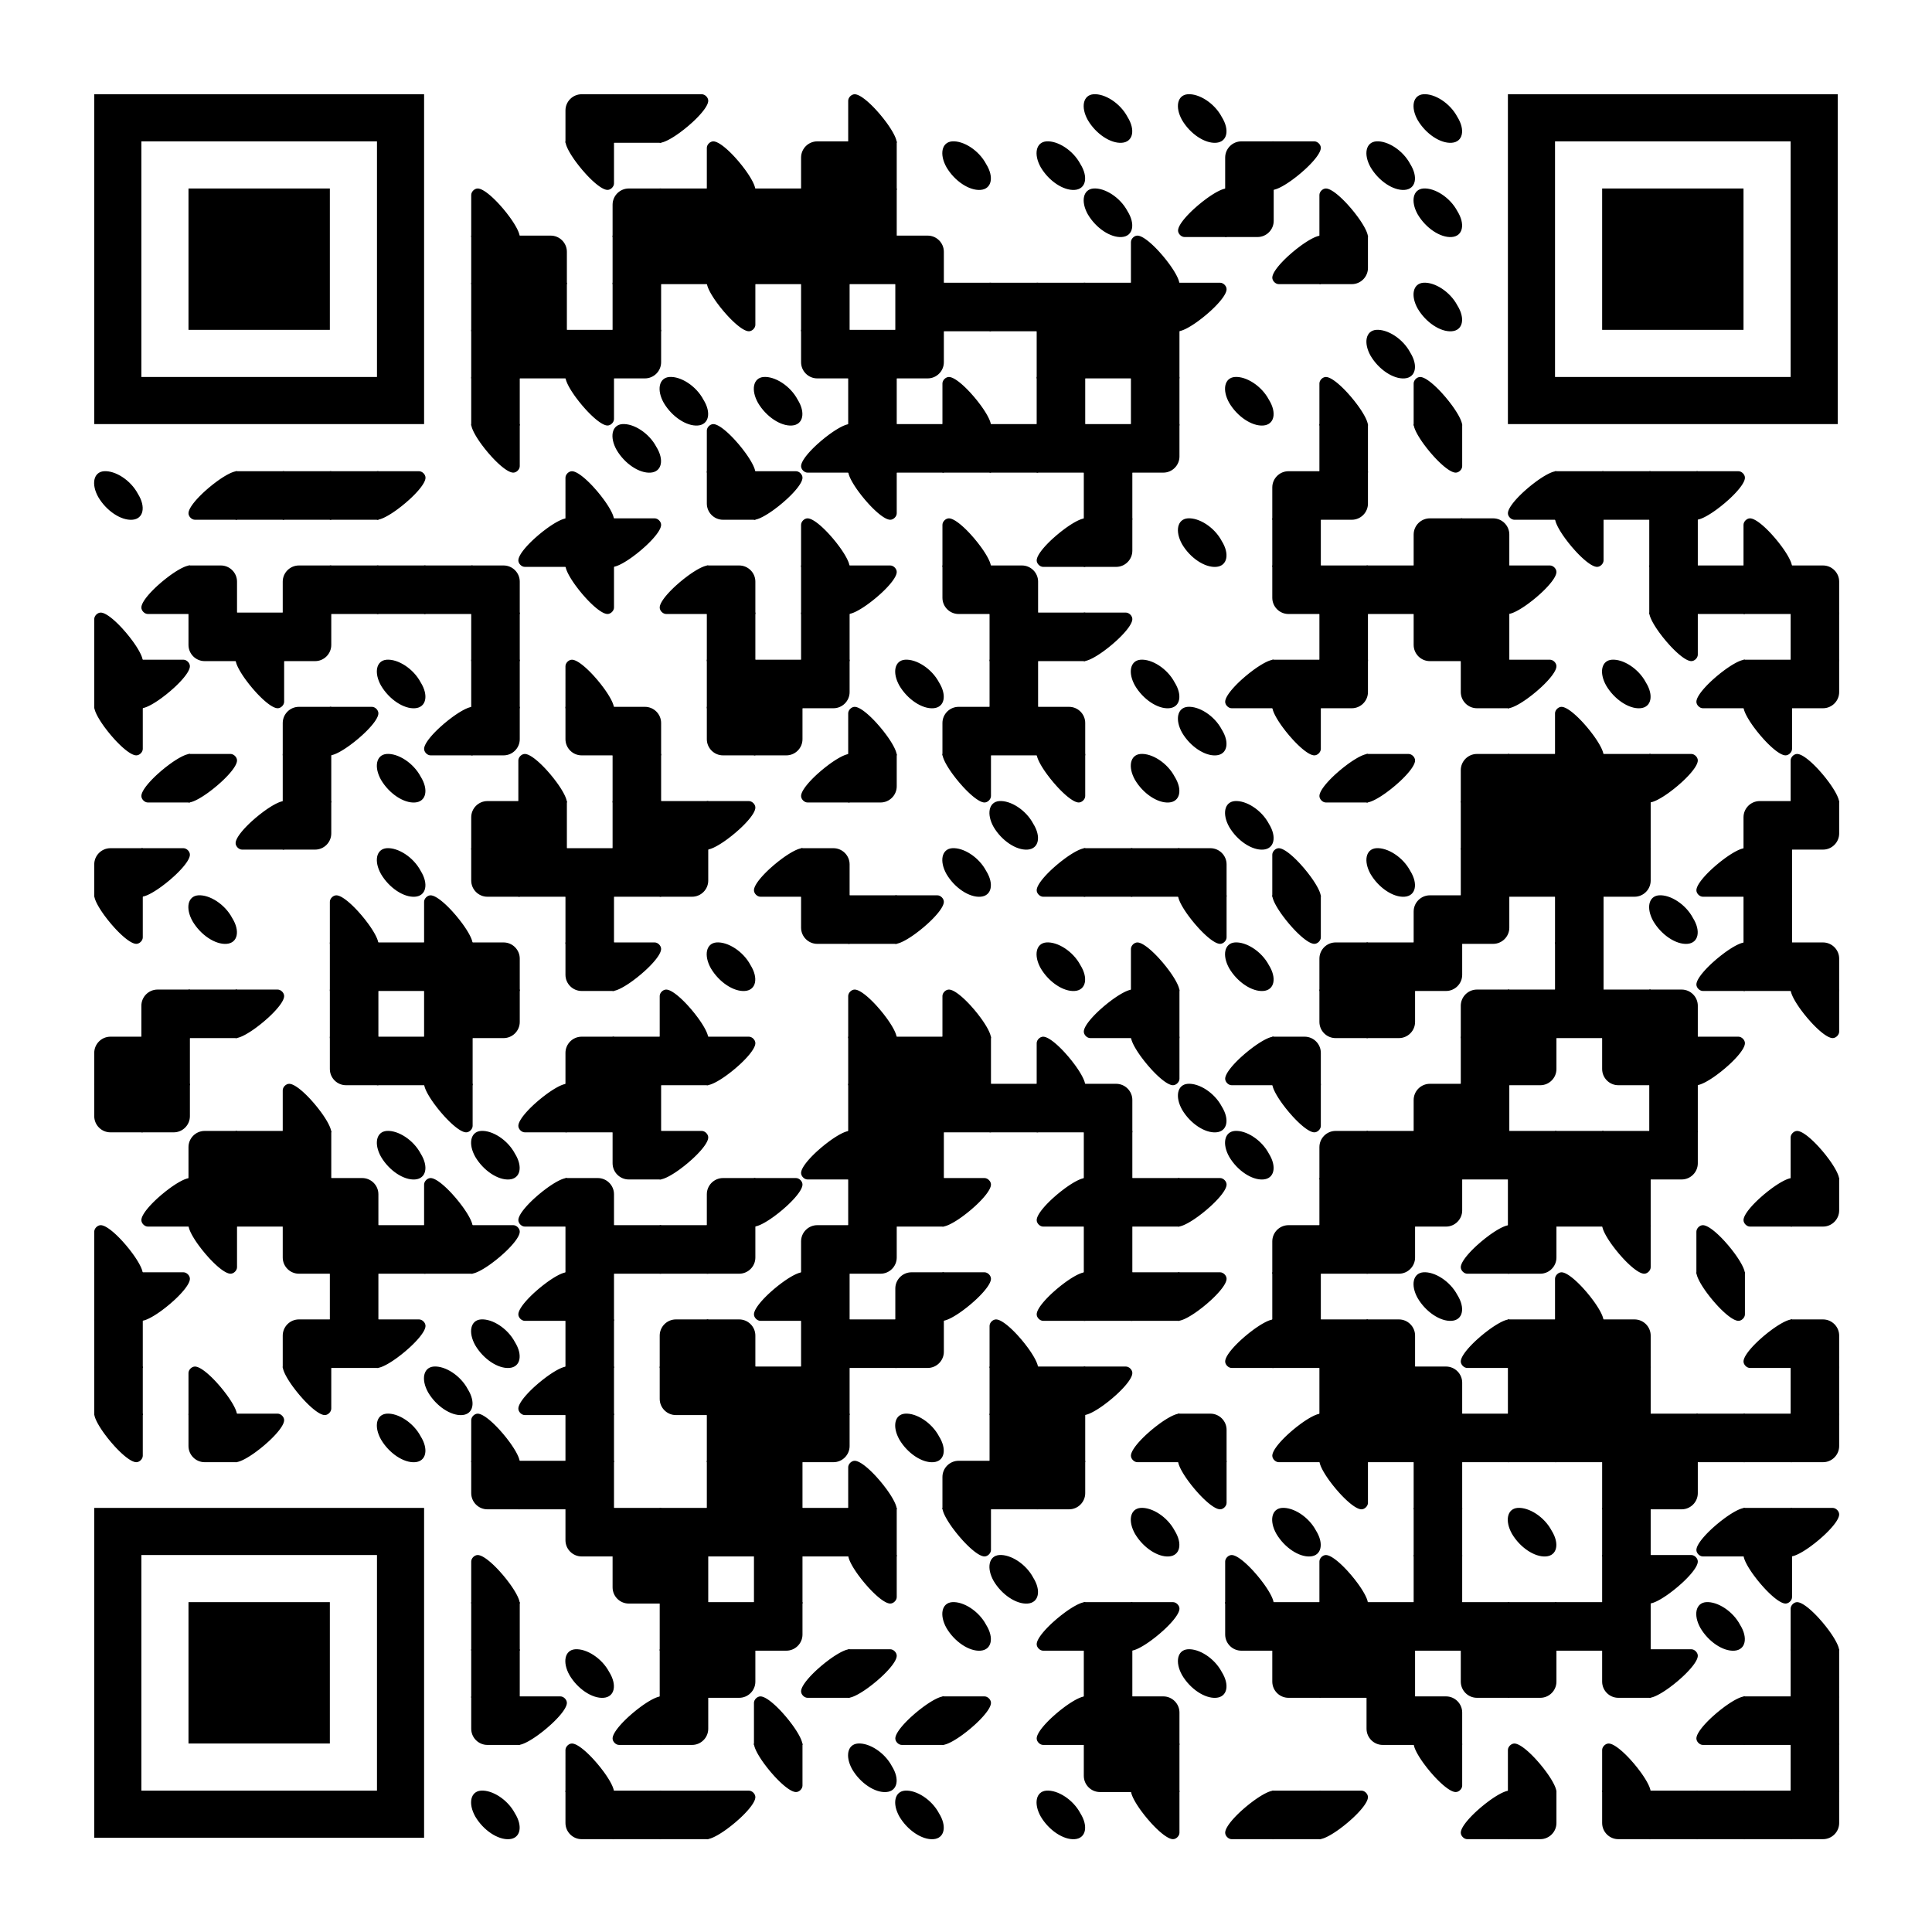



Thank you!
Collaborators:
Paper
Code
Mira Becker
Marija Bolic
All of MPRL!
Fiery Cushman
Funders:
scholar.harvard.edu/xrg

